Slide 1
Data Access with ADO.NET
Dr. Herbert Praehofer
Institute for System Software
Johannes Kepler University Linz
Dr. Dietrich Birngruber
Ecolog GmbH
Wels
© University of Linz, Institute for System Software, 2004
published under the Microsoft Curriculum License

Slide 2
ADO.NET
Introduction
Connection-oriented Access
Transactions
Connectionless Access
Database Access with DataAdapter
DataSets and DataReader
Integration with XML
Summary

Slide 3
ADO.NET
Is the .NET technology for accessing structured data
Uniform object oriented interface for different data sources
  relational data bases
  XML data
  other data sources
Designed for distributed and Web applications
Provides 2 models for data access
  connection-oriented
  connectionless
Notes:
Überblick

Slide 4
Idea of Universal Data Access
Connection of (object-oriented) programming languages and relational data bases
Uniform programming model and API
Special implementations for data sources (providers)
MsSql
DB2
Application
API
Oracle
?
ODBC
provider

Slide 5
Data Providers
Microsoft’s layered architecture for data access
ADO.NET
SQL Server
Oracle
MySQL
ODBC
OLEDB
SQL-data
Non-SQL-data
MS SQL Server, Oracle,
Jet, Foxpro, ...
Directory Services, Mail,
Text, Video, ...

Slide 6
History of Universal Data Access
(Microsoft)
ODBC
  OLE DB
    ADO (ActiveX Data Objects)
      ADO.NET
ADO | ADO.NET
connection-oriented | connection-oriented + connectionless
sequential access | sequential access + main-memory representation with direct access
only one table supported | more than one table supported
COM-marshalling | XML-marshalling
Notes:
Überblick

Slide 7
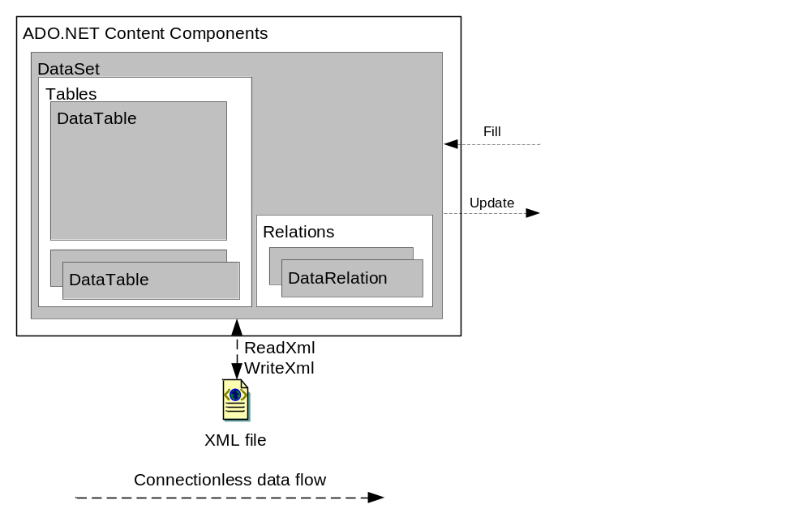
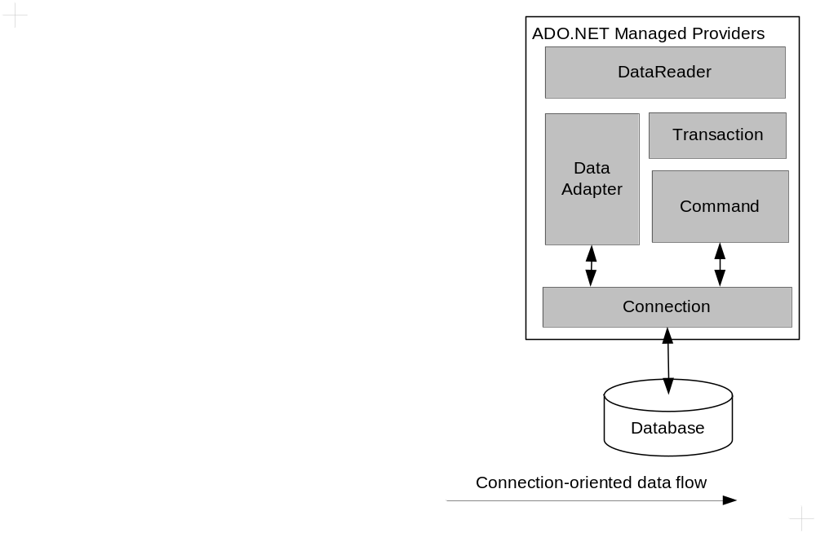
Architecture of ADO.NET
connectionless
connection-oriented

Slide 8
Connection-oriented versus Connectionless
Connection-oriented
  Keeps the connection to the data base alive
  Always up-to-date data
  Intended for applications with:
    short running transactions
    only a few parallel access operations
Connectionless
  No permanent connection to the data source
  Data cached in main memory
  Changes in main memory may be in conflict with changes in data source
  Intended for applications with:
    many parallel and long lasting access operations (e.g.: Web applications)

Slide 9
ADO.NET Assembly and Namespaces
Assembly
  System.Data.dll
Namespaces:
  System.Data general types
  System.Data.Common classes for implementing providers
  System.Data.OleDb OLE DB provider
  System.Data.SqlClient Microsoft SQL Server provider
  System.Data.SqlTypes data types for SQL Server
  System.Data.Odbc ODBC provider (since .NET 1.1)
  System.Data.OracleClient Oracle provider (since .NET 1.1)
  System.Data.SqlServerCe Compact Framework

Slide 10
ADO.NET
Introduction
Connection-oriented Access
Transactions
Connectionless Access
Database Access with DataAdapter
DataSets and DataReader
Integration with XML
Summary

Slide 11
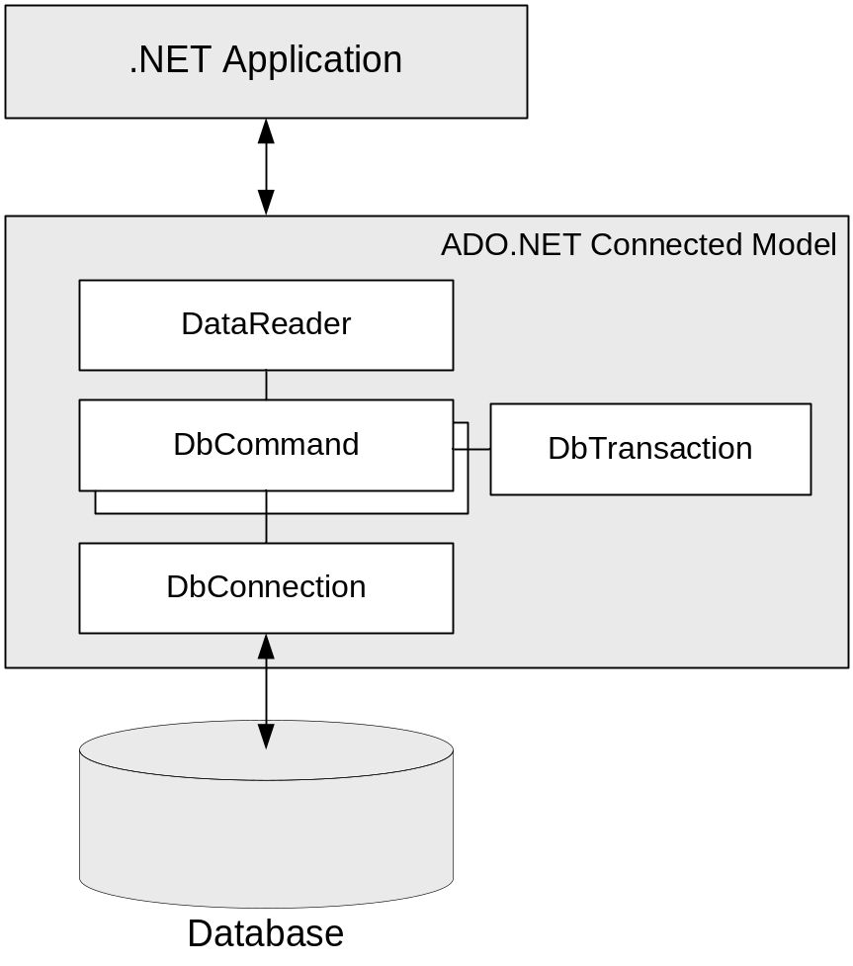
Architecture
DbConnection
  represents connection to data source
DbCommand
  represents a SQL command
DbTransaction
  represents a transaction
  commands can be executed within a transaction
DataReader
  result of a data base query
  allows sequential reading of rows

Slide 12
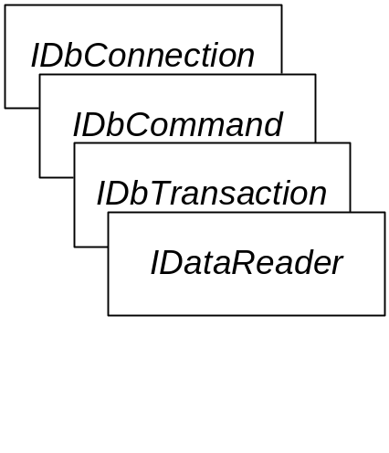

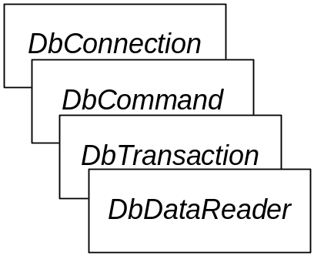
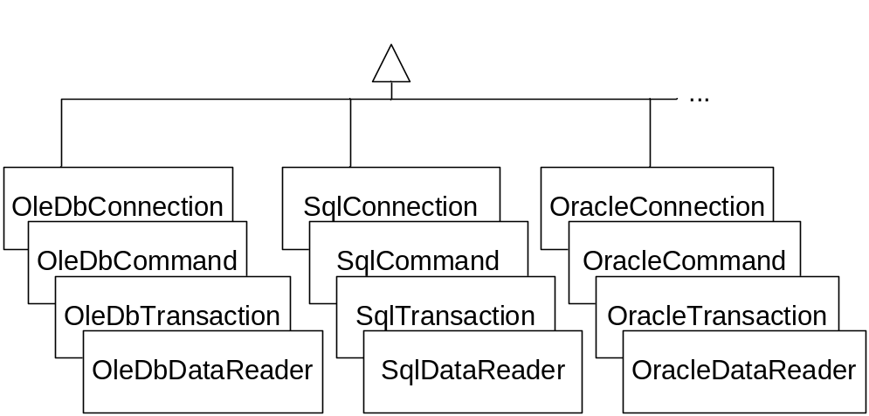
Class hierarchy
General interfaces
  IDbConnection
  IDbCommand
  IDbTransaction
  IDataReader
Abstract base classes
  DbConnection
  DbCommand
  DbTransaction
  DbDataReader
Special implementations
  OleDb: implementation for OLEDB
  Sql: implementation for SQL Server
  Oracle: implementation for Oracle
  Odbc: implementation for ODBC
  SqlCe: implementation for SQL Server CE data base

Slide 13
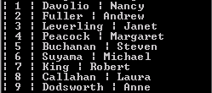
Example: Northwind Database
Microsoft Example for SQL Server
Reading of table Employees
Output of
  EmployeesID, LastName, FirstName
for all rows of table Employees
Run

Slide 14
Program Pattern for
Connection-oriented Data Access
1.) Declare connection
try {
1.) Request connection to database
2.) Execute SQL commands
3.) Process result
4.) Release Resources
} catch ( Exception ) {
Handle exception
} finally {
try {
4.) Close connection
} catch (Exception)
{ Handle exception }
}

Slide 15
Example: EmployeeReader (1)
using System;
using System.Data;
using System.Data.OleDb;
public class EmployeeReader {
public static void Main() {
1) Declare and request connection to database
string connStr = "provider=SQLOLEDB; data source=(local)\\NetSDK; " +
"initial catalog=Northwind; user id=sa; password=; ";
IDbConnection con = null; // declare connection object
try {
con = new OleDbConnection(connStr); // create connection object
con.Open(); // open connection
2) Execute SQL commands
//----- create SQL command
IDbCommand cmd = con.CreateCommand();
cmd.CommandText = "SELECT EmployeeID, LastName, FirstName FROM Employees";
//----- execute SQL command; result is an OleDbDataReader
IDataReader reader = cmd.ExecuteReader();
// continue next page

Slide 16
Example: EmployeeReader (2)
3) Read and process data rows
IDataReader reader = cmd.ExecuteReader();
object[] dataRow = new object[reader.FieldCount];
while (reader.Read()) {
int cols = reader.GetValues(dataRow);
for (int i = 0; i < cols; i++) Console.Write("| {0} " , dataRow[i]);
Console.WriteLine();
}
4) Release resources and close connection
//----- close reader
reader.Close();
} catch (Exception e) {
Console.WriteLine(e.Message);
} finally {
try {
if (con != null)
// ----- close connection
con.Close();
} catch (Exception ex) { Console.WriteLine(ex.Message); }
}
}
}

Slide 17
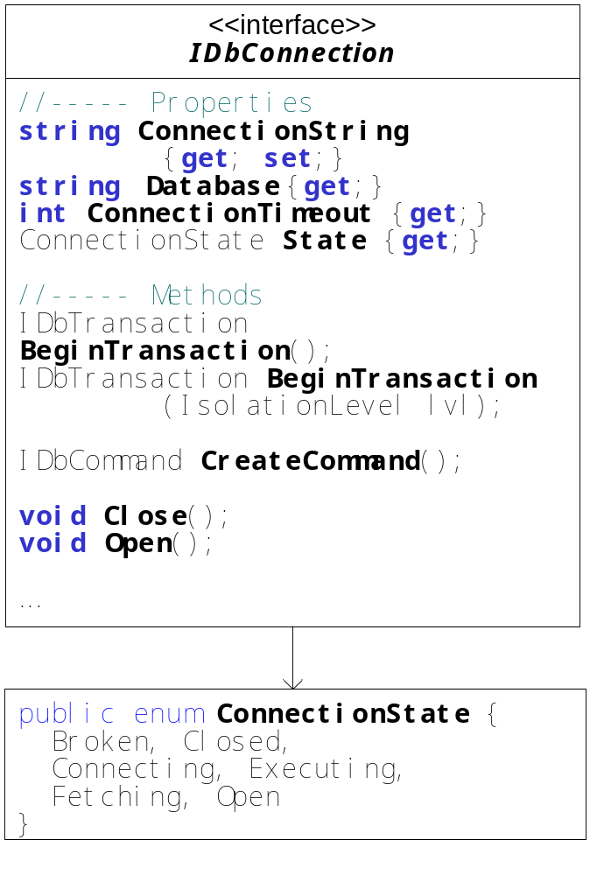
Interface IDbConnection
ConnectionString defines data base connection
Open and close connection
Properties of connection object
Creates Command-Object
Creates Transaction-Object
string ConnectionString {get; set;}
void Open();
void Close();
string Database {get;}
int ConnectionTimeout {get;}
ConnectionState State {get;}
IDbCommand CreateCommand();
IDbTransaction BeginTransaction();
IDbTransaction BeginTransaction(IsolationLevel lvl);
Notes:
Überblick

Slide 18
IDbConnection: Property ConnectionString
Key-value-pairs separated by semicolon (;)
Configuration of the connection
  name of the provider
  identification of data source
  authentication of user
  other database-specific settings
e.g.: OLEDB:
  "provider=SQLOLEDB; data source=127.0.0.1\\NetSDK;
  initial catalog=Northwind; user id=sa; password=; "
  "provider=Microsoft.Jet.OLEDB.4.0;data source=c:\bin\LocalAccess40.mdb;"
  "provider=MSDAORA; data source=ORACLE8i7; user id=OLEDB; password=OLEDB;“
e.g.: MS-SQL-Server:
  "data source=(local)\\NetSDK; initial catalog=Northwind; user id=sa;
  pooling=false; Integrated Security=SSPI; connection timout=20;"
SqlServer
Access
Oracle
Notes:
Überblick

Slide 19
DbProviderFactory
Writing database-independent programs with DbProviderFactory
DbProviderFactory generates set of provider-specific components
Provider can be configured in an easy way (e.g. in configuration file)
DbProviderFactory factory = DbProviderFactories.GetFactory("System.Data.SqlClient");
IDbConnection conn = factory.CreateConnection();
IDbCommand cmd = factory.CreateCommand();
cmd.Connection = conn;
IDataParameter param = factory.CreateParameter();
create DbProviderFactory for SqlClient
create provider specific data access components
DBConnection
DbCommand
DataParameter

Slide 20
ConnectionStringBuilder
Creation of connection string can be error-prone
ConnectionStringBuilder provides support:
  Definition with key-value pairs
  Validation of syntactical correctness and completeness
DbConnectionStringBuilder builder =
factory.CreateConnectionStringBuilder();
builder["Server"] = "localhost\\SQLEXPRESS";
builder["Initial Catalog"] = "Northwind";
builder["Integrated Security"] = true;
conn.ConnectionString = builder.ConnectionString;
conn.Open();
create ConnectionStringBuilder
and set values
retrieve connection string and configure connection

Slide 21
Command Objects
IDbTransaction
0..1
*
IDbCommand
1
*
IDataParameter
1
IDbConnection
Command objects define SQL statements or stored procedures
Executed for a connection
May have parameters
May belong to a transaction

Slide 22
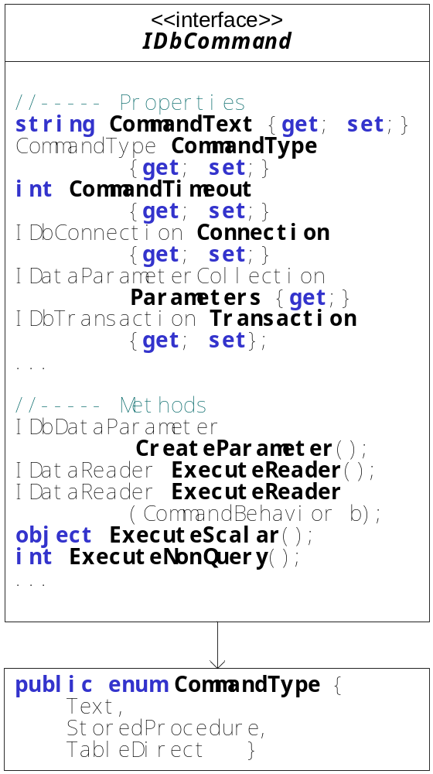
Interface IDbCommand
CommandText defines SQL statement or stored procedure
Connection object
Type and timeout properties
Creating and accessing parameters
Execution of command
string CommandText {get; set;}
IDbConnection Connection {get; set;}
CommandType CommandType {get; set;}
int CommandTimeout {get; set;}
IDbDataParameter CreateParameter(); IDataParameterCollection Parameters {get;}
IDataReader ExecuteReader();
IDataReader ExecuteReader(CommandBehavior b);
int ExecuteNonQuery();
object ExecuteScalar();

Slide 23
ExecuteReader Method
IDataReader ExecuteReader()
IDataReader ExecuteReader( CommandBehavior behavior );
public enum CommandBehavior {
CloseConnection, Default, KeyInfo, SchemaOnly,
SequentialAccess, SingleResult, SingleRow
}
Executes the data base query specified in CommandText
Result is an IDataReader object
Example:
cmd.CommandText =
"SELECT EmployeeID, LastName, FirstName FROM Employees ";
IDataReader reader = cmd.ExecuteReader();
Notes:
Überblick

Slide 24
ExecuteNonQuery Method
int ExecuteNonQuery();
Executes the non-query operation specified in CommandText
  UPDATE
  INSERT
  DELETE
  CREATE TABLE
  …
Result is number of affected rows
Example:
cmd.CommandText = "UPDATE Empls SET City = ’Seattle’ WHERE iD=8";
int affectedRows = cmd.ExecuteNonQuery();

Slide 25
ExecuteScalar Method
object ExecuteScalar();
Returns the value of the 1st column of the 1st row delivered by the query
CommandText typically is an aggregate function
Example:
cmd.CommandText = " SELECT count(*) FROM Employees ";
int count = (int) cmd.ExecuteScalar();
Notes:
Überblick

Slide 26
Asynchronous Command Execution
So far only synchronous execution of commands
ADO.NET 2.0 supports asynchronous execution mode
(similar to asynchronous IO operations)
Allows execution of commands in background thread
IAsyncResult BeginExecuteReader (AsyncCallback callback)
IDataReader EndExecuteReader (AsyncResult result)
IAsyncResult BeginExecuteNonQuery (AsyncCallback callback)
int EndExecuteNonQuery (IAsyncResult result)
IAsyncResult BeginExecuteXmlReader (AsyncCallback callback)
IDataReader EndExecuteXmlReader (IAsyncResult result)

Slide 27
Example Asynchronous Command Execution
...
public class Async {
SqlCommand cmd; //---- command which should be executed asynchronously
public void CallCmdAsync() {
SqlConnection conn = new SqlConnection(
"Data Source=(local)\\NetSDK...; Asynchronous Processing=true");
cmd = new SqlCommand("MyLongRunningStoredProc", conn);
cmd.CommandType = CommandType.StoredProcedure;
conn.Open();
//---- start asynchronous execution of command
cmd.BeginExecuteNonQuery(new AsyncCallback(AsyncCmdEnded), null);
...
}
//---- callback method called at the end of the execution of command
public void AsyncCmdEnded(IAsyncResult result) {
//---- process result of command
int affectedRows = cmd.EndExecuteNonQuery(result);
...
}
}
Callback when query is finished

Slide 28
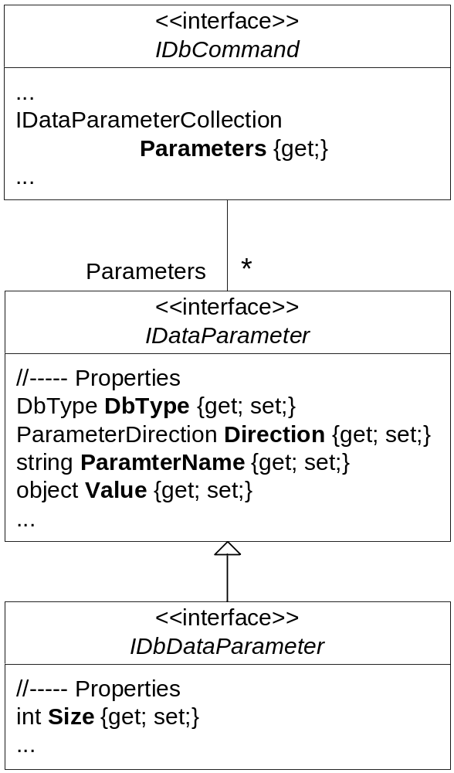
Parameters
Command objects allow input and output parameters
Parameter objects specify
  Name: name of the parameter
  Value: value of the parameter
  DbDataType: data type of the parameter
  Direction: direction of the parameter
    Input
    Output
    InputOutput
    ReturnValue
IDataParameterCollection Parameters {get;}

Slide 29
Working with Parameters
1. Define SQL command with place holders
  OLEDB: Identification of parameters by position (notation: "?")
  SQL Server: Identification of parameters by name (notation: "@name")
OleDbCommand cmd = new OleDbCommand();
cmd.CommandText = "DELETE FROM Empls WHERE EmployeeID = ?";
SqlCommand cmd = new SqlCommand();
cmd.CommandText = "DELETE FROM Empls WHERE EmployeeID = @ID";
2. Create and add parameter
cmd.Parameters.Add( new OleDbParameter("@ID", OleDbType.BigInt));
3. Assign values and execute command
cmd.Parameters["@ID"].Value = 1234;
cmd.ExecuteNonQuery();

Slide 30
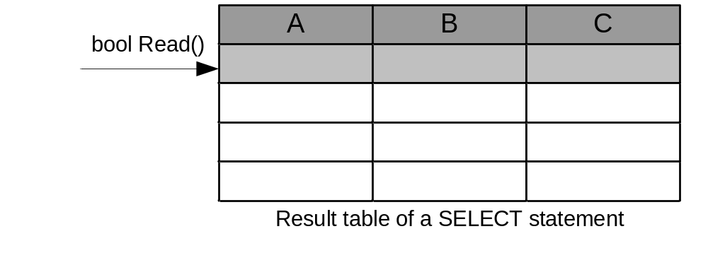
DataReader
ExecuteReader() returns IDataReader object
IDataReader allows sequential reading of result (row by row)
IDataReader ExecuteReader()
IDataReader ExecuteReader( CommandBehavior behavior );

Slide 31
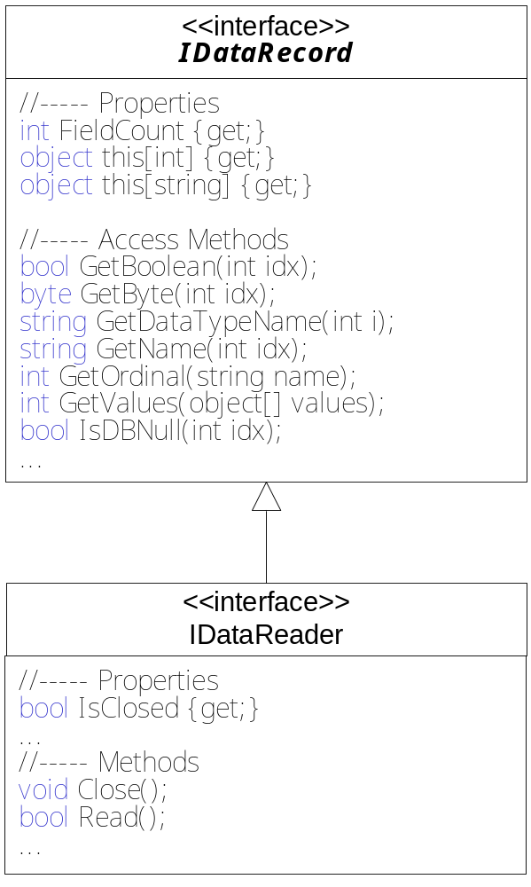
Interface IDataReader
Read reads next row
Access column values using indexers
Typed access of column values using access methods
Getting meta-information
bool Read();
object this[int] {get;}
object this[string] {get;}
bool GetBoolean(int idx);
byte GetByte(int idx);
...
string GetDataTypeName(int i);
string GetName(int idx);
int GetOrdinal(string name);
...
Notes:
Überblick

Slide 32
Working with IDataReader
Create IDataReader object and read rows
IDataReader reader = cmd.ExecuteReader();
while (reader.Read()) {
Read column values into an array
object[ ] dataRow = new object[reader.FieldCount];
int cols = reader.GetValues(dataRow);
Read column values using indexers
object val0 = reader[0];
object nameVal = reader["LastName"];
Read column value using typed access method getString
string firstName = reader.getString(2);
Close IDataReader object
}
reader.Close();

Slide 33
Multiple Active Result Sets (MARS)
Usually only one DataReader
ADO.NET 2.0 allows several DataReaders in parallel
more than one table can be read simultaneously
only with SQL Server

Slide 34
Example MARS (1)
reading Customer und Orders table simultaneously
output of the orders for each customer
SqlConnection conn = new SqlConnection("...;MultipleActiveResultSets=true");
conn.Open();
//---- creation of two command objects for one connection
SqlCommand custCmd = new SqlCommand(
"SELECT CustomerId, CompanyName " +
"FROM Customers ORDER BY CustomerId", conn);
SqlCommand ordCmd = new SqlCommand(
"SELECT CustomerId, OrderId, OrderDate " +
"FROM Orders ORDER BY CustomerId, OrderDate", conn);
//---- execution of commands and creation of two DataReaders
IDataReader custRdr = custCmd.ExecuteReader();
IDataReader ordRdr = ordCmd.ExecuteReader();

Slide 35
Example MARS (2)
…
//---- reading data using both DataReaders simultaneously
string custId = null;
bool moreOrders = ordRdr.Read();
while (custRdr.Read() && moreOrders) { // loop over all customers
custId = custRdr.GetString(0);
string custName = custRdr.GetString(1);
while (moreOrders && custId == ordRdr.GetString(0)) {// loop over orders of customer
Console.WriteLine(custName + " ordered " + ordRdr.GetInt32(1) +
" at " + ordRdr["OrderDate"]);
moreOrders = ordRdr.Read();
}
}
custRdr.Close();
ordRdr.Close();

Slide 36
ADO.NET
Introduction
Connection-oriented Access
Transactions
Connectionless Access
Database Access with DataAdapter
DataSets and DataReader
Integration with XML
Summary

Slide 37
ADO.NET and Transactions
2 transaction models
local transactions:
  transactions for one connection
  provided by ADO.NET
distributed transactions:
  transactions for several connections
  usage of Microsoft Distributed Transaction Component (MSDTC)
  namespace System.Transaction

Slide 38
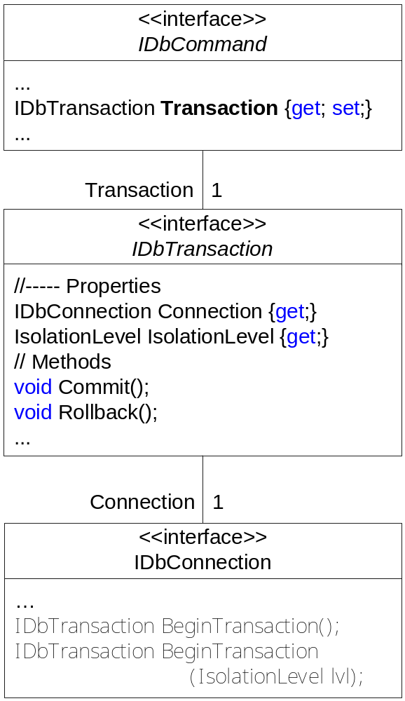
Local Transactions with ADO.NET
ADO.NET supports transactions
Commands can be executed within transactions
Execution of commands are
  committed with Commit
  aborted with Rollback

Slide 39
Example Local Transactions (1)
1. Define connection and create Transaction object
SqlConnection con = new SqlConnection(connStr);
IDbTranaction trans = null;
try {
con.Open();
trans = con.BeginTransaction(IsolationLevel.ReadCommitted);
2. Create Command object, assign it to Transaction object, and execute it
IDbCommand cmd1 = con.CreateCommand();
cmd1.CommandText = "DELETE [OrderDetails] WHERE OrderId = 10258";
cmd1.Transaction = trans;
cmd1.ExecuteNonQuery();
IDbCommand cmd2 = con.CreateCommand();
cmd2.CommandText = "DELETE Orders WHERE OrderId = 10258";
cmd2.Transaction = trans;
cmd2.ExecuteNonQuery();

Slide 40
Example Local Transactions(2)
3. Commit or abort transaction
trans.Commit();
catch (Exception e) {
if (trans != null)
trans.Rollback();
} finally {
try {
con.Close();
}
}

Slide 41
Isolation Levels for Transactions
Isolation levels define usage of read and write locks in transaction
ADO.NET transactions allow different isolation levels
public enum IsolationLevel {
ReadUncommitted, ReadCommitted, RepeatableRead, Serializable, ...
}
ReadUncommitted | Allows reading of locked data Dirty reads possible
ReadCommitted (Standard) | Reading of locked data prohibited No dirty reads but phantom rows can occur Non-repeatable reads
RepeatableRead | Same as ReadCommitted but repeatable reads
Serializable | Serialized access Phantom rows cannot occur
Notes:
Überblick

Slide 42
Locking within Transactions
Using locks for prohibiting simultaneous access of table and rows
Writer
Reader
BeginTransaction
Phenomenons (within one transaction):
  Dirty reads: Reading of locked rows allowed
  Phantom rows: Added rows not read
  Repeatable reads: reads always deliver same result
Read
Change
Add
Read
EndTransaction

Slide 43
Distributed Transactions
Transaction over several connection and several data bases
Usage of
Microsoft Distributed Transaction Component (MSDTC)
MSDTC must be installed and started
Namespace System.Transaction
2 models:
  explicit model (class CommitableTransaction)
  implicit model (class TransactionScope)

Slide 44
Explicit Model with CommitableTransaction
Allocation of connection to CommitableTransactions with
  connection.EnlistTransaction(transaction)
Example:
Create connection objects, CommitableTransaction object and command objects
and open connection
SqlConnection con1 = new SqlConnection(connStr1);
SqlConnection con2 = new SqlConnection(connStr2);
CommittableTransaction trans = new CommittableTransaction();
try {
con1.Open();
con2.Open();
IDbCommand cmd1 = con1.CreateCommand();
IDbCommand cmd2 = con2.CreateCommand();
…

Slide 45
Explicit Model with CommitableTransaction
Example (cont.)
Register connections with transaction object
con1.EnlistTransaction(trans);
con2.EnlistTransaction(trans);
Execute the commands within the transaction
cmd1.CommandText =
"UPDATE Employees SET Extension=777 WHERE LastName = 'King'";
cmd1.ExecuteNonQuery();
cmd2.CommandText =
"UPDATE Contact SET Phone=9999 WHERE Name = 'King'";
cmd2.ExecuteNonQuery();
Commit changes or rollback in case of exceptions
trans.Commit();
}
catch (Exception e) {
trans.Rollback();
}

Slide 46
Implicit Model with TransactionScope
Creating and managing of transaction objects automatically
using transaction scope (class TransactionScope)
Approach:
  code block is marked to participate in transaction
  all connections opened within block run within same transaction
  finalize transaction with Complete
  leaving block without Complete means rollback

Slide 47
Example TransactionScope
Create TransactionScope object for a local block (using statement)
//---- same connections as in example with CommitableTransaction
try {
using (TransactionScope transScope =
new TransactionScope(TransactionScopeOption.RequiresNew)) {
Open connection and execute commands ;
all connection opened in block are assigned to same transaction
con1.Open();
con2.Open();
IDbCommand cmd1 = con1.CreateCommand();
cmd1.CommandText = "UPDATE Employees SET Extension=1234 WHERE LastName = 'King'";
cmd1.ExecuteNonQuery();
IDbCommand cmd2 = con2.CreateCommand();
cmd2.CommandText = "UPDATE Contact SET Phone=1234 WHERE Name = 'King'";
cmd2.ExecuteNonQuery();
When Complete is executed, changes are committed, otherwise discarded
transScope.Complete();
}
}
catch (Exception e) { ... }

Slide 48
ADO.NET
Introduction
Connection-oriented Access
Transactions
Connectionless Access
Database Access with DataAdapter
DataSets and DataReader
Integration with XML
Summary

Slide 49
Motivation and Idea
Motivation
  Many parallel, long lasting access operations
  Connection-oriented data access too costly
Idea
  Caching data in main memory
    ➔ “main memory data base“
  Only short connections for reading and updates
    ➔ DataAdapter
  Main memory data base independent from data source
    conflicting changes are possible

Slide 50
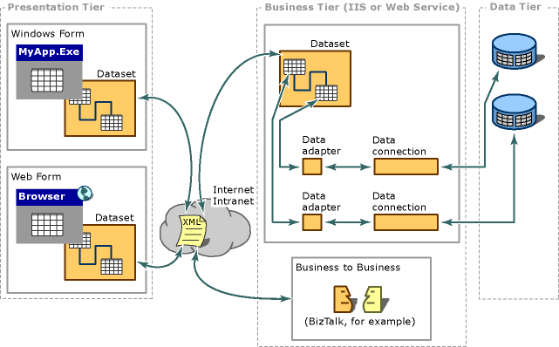
Microsoft 3-Tier Architecture
taken from: Introduction to Data Access with ADO.NET, http://msdn.microsoft.com/library/

Slide 51
ADO.NET Technology Chain
DataAdapter
Conn
ection
Data
store
XML
DataAdapter
Conn
ection
Data
store
DataGrid
DataView
DataSet
DataSet

Slide 52
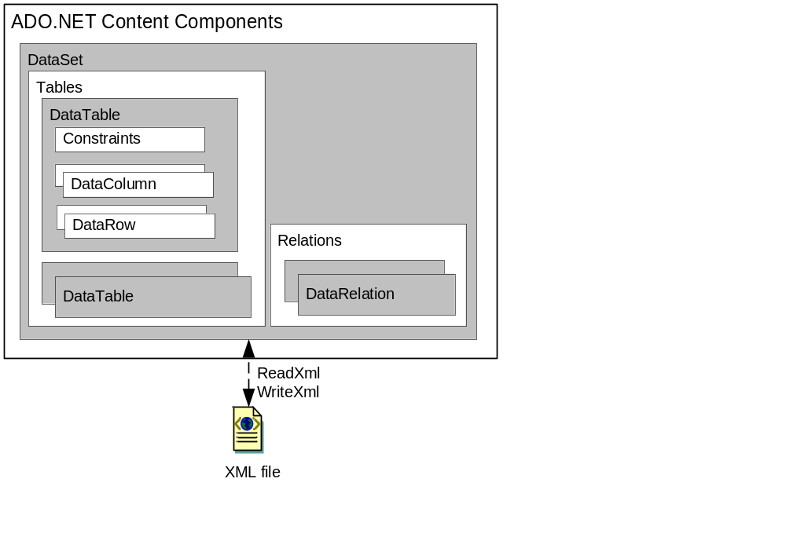
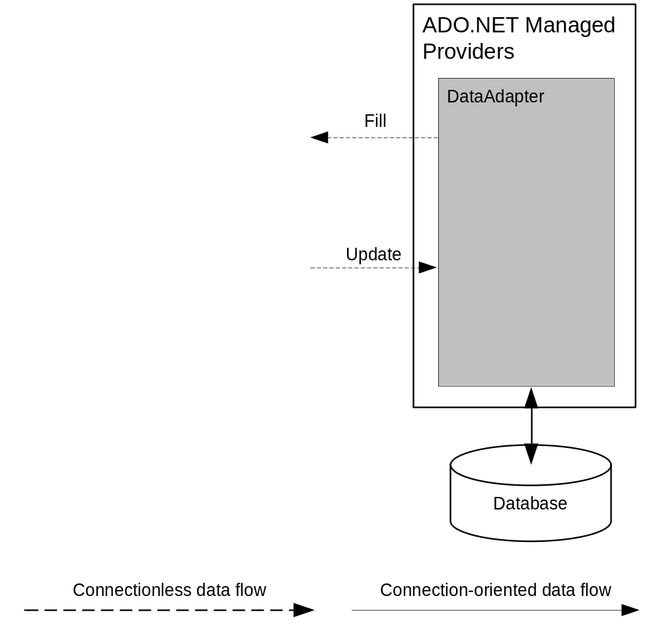
Architecture of Connectionless Data Access
connectionless
connection-oriented

Slide 53
DataSet Structure
DataSet
.Tables[...]
.Relations[...]
...
DataTable
.Columns[..]
.Rows[..]
DataTable
.Columns[...]
.Rows[...]
.DefaultView
...
schema
DataColumn
DataColumn
DataRow
data
DataRow
DataView
DataRelation
DataRelation

Slide 54
DataSet
Main memory data base
  relational structure
  object oriented interface
DataSet consists of
  collection of DataTables
  collection of DataRelations
DataTables consists of
  collection of DataTableColumns (= schema definition)
  collection of DataTableRows (= data)
  DefaultView (DataTableView, see later)
DataRelations
  associate two DataTable objects
  define ParentTable and ParentColumns
  and ChildTable and ChildColumns

Slide 55
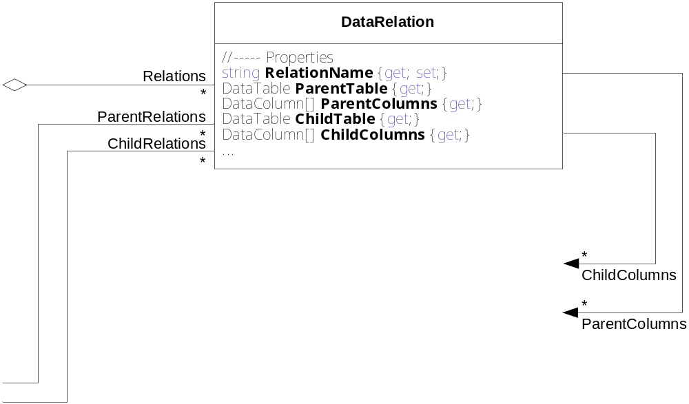
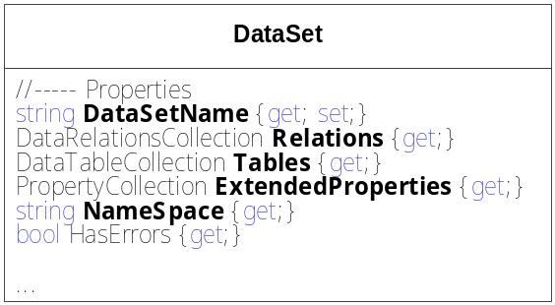
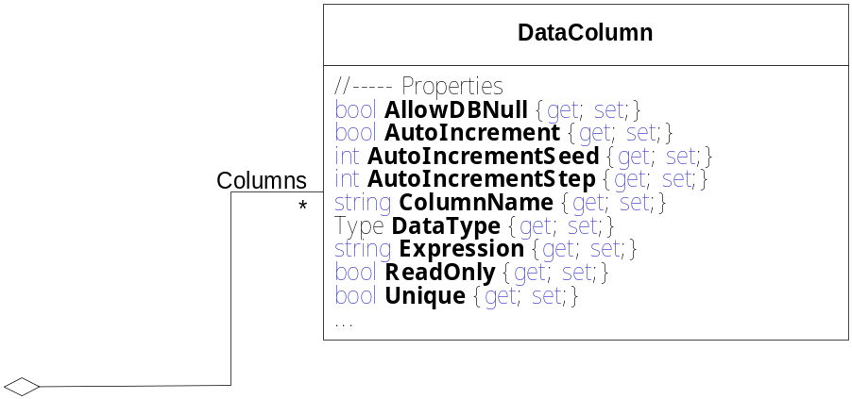
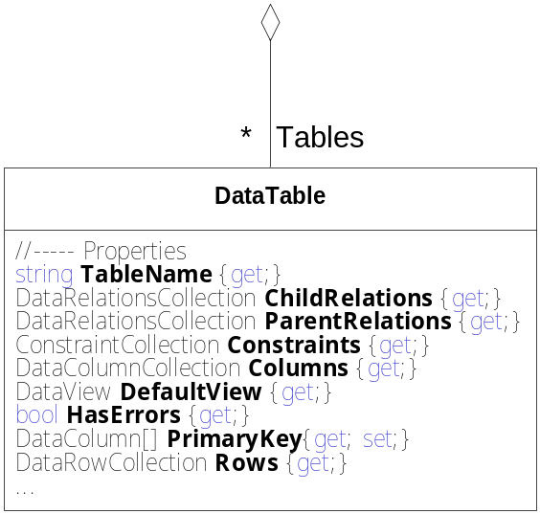
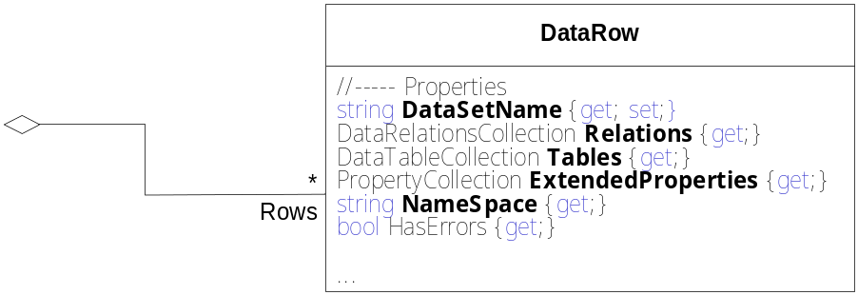
DataSet Class Diagram

Slide 56
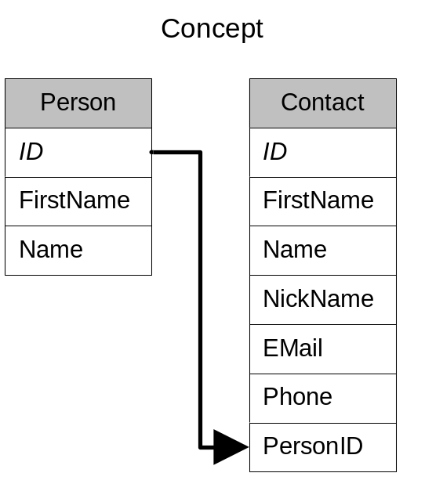
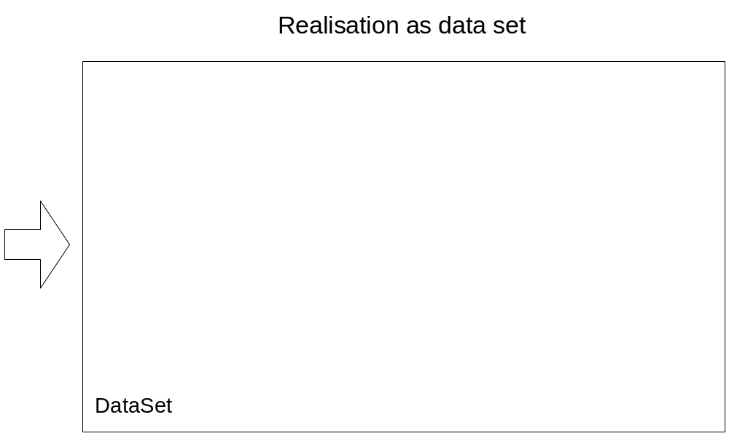
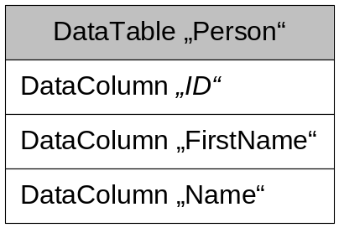
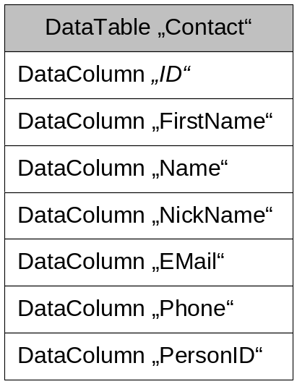

Example: Person Contacts
Implementation steps:
Define schema
Define data
Access data

Slide 57
Person Contacts: Define Schema (1)
Create DataSet and DataTable "Person"
DataSet ds = new DataSet("PersonContacts");
DataTable personTable = new DataTable("Person");
Define column "ID" and set properties
DataColumn col = new DataColumn();
col.DataType = typeof(System.Int64);
col.ColumnName = "ID";
col.ReadOnly = true;
col.Unique = true; // values must be unique
col.AutoIncrement = true; // keys are assigned automatically
col.AutoIncrementSeed = -1; // first key starts with -1
col.AutoIncrementStep = -1; // next key = prev. key - 1
Add column to table and set as primary key
personTable.Columns.Add(col);
personTable.PrimaryKey = new DataColumn[ ] { col };
Notes:
Überblick

Slide 58
Person Contacts: Define Schema (2)
Define and add column "FirstName"
col = new DataColumn();
col.DataType = typeof(string);
col.ColumnName = "FirstName";
personTable.Columns.Add(col);
Define and add column "Name"
col = new DataColumn();
col.DataType = typeof(string);
col.ColumnName = "Name";
personTable.Columns.Add(col);
Add table to DataSet
ds.Tables.Add(personTable);
Create table "Contact" in similar way
DataTable contactTable = new DataTable("Contact");
...
ds.Tables.Add(contactTable);

Slide 59
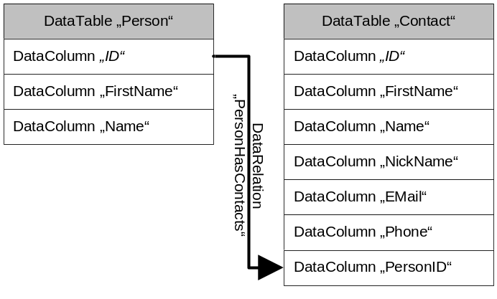
Person Contacts: Define Relation
Create relation PersonHasContacts
and add it to the DataSet
DataColumn parentCol = ds.Tables["Person"].Columns["ID"];
DataColumn childCol = ds.Tables["Contact"].Columns["PersonID"];
DataRelation rel = new DataRelation("PersonHasContacts", parentCol, childCol);
ds.Relations.Add(rel);

Slide 60
Person Contacts: Define Data Rows
Create new row and assign column values
DataRow personRow = personTable.NewRow();
personRow[1] = "Wolfgang";
personRow["Name"] = "Beer";
Add row to table "Person"
personTable.Rows.Add(row);
Create and add row to table "Contact"
DataRow contactRow = contactTable.NewRow ();
contactRow[0] = "Wolfgang";
...
contactRow["PersonID"] = (long)personRow["ID"]; // defines relation
contactTable.Rows.Add (row);
Commit changes
ds.AcceptChanges();

Slide 61
Person Contacts: Access Data
Iterate over all persons of personTable and put out the names
foreach (DataRow person in personTable.Rows) {
Console.WriteLine("Contacts of {0}:", person["Name"]);
Access contacts through relation "PersonHasContacts"
and print out contacts
foreach (DataRow contact in person.GetChildRows("PersonHasContacts")) {
Console.WriteLine("{0}, {1}: {2}", contact[0], contact["Name"], contact["Phone"] );
}

Slide 62
DataSet: Change Management
DataSets maintain all changes
Changes are accepted with acceptChanges
or discarded with rejectChanges
...
if (ds.HasErrors) {
ds.RejectChanges();
} else {
ds.AcceptChanges();
}
}

Slide 63
DataRowVersion
DataSets store different versions of data row values:
  Current: current values
  Original: original values
  Proposed: proposed values (values which are currently processed)
  Default: standard, based on DataRowState
public enum DataRowVersion {
Current, Original, Proposed, Default
}
DataRowState | Default
Added, Modified, Unchanged | Current
Deleted | Original
Detached | Proposed
Example:
bool hasOriginal = personRow.HasVersion(DataRowVersion.Original);
if (hasOriginal) {
string originalName = personRow["Name", DataRowVersion.Original];
}

Slide 64
State Diagram of a DataRow object
DataRow objects have different states
public DataRowState RowState {get;}
public enum DataRowState {
Added, Deleted, Detached, Modified, Unchanged
}
Detached
row=table.NewRow
table.Row.
Remove(row)
table.Row.
Add(row)
Reject-
Changes
row[…] = …
row.
Delete
Reject-
Changes
Added
Accept-
Changes
Unchanged
Modified
Accept-
Changes
Accept-
Changes
Deleted
RejectChanges
row.Delete
row.Delete
Notes:
Überblick

Slide 65
Exception Handling
ADO.NET checks validity of operations on DataSets
and throws DataExceptions
DataException
ConstraintException
DeletedRowInaccessibleExcception
DuplicateNameException
InvalidConstraintException
InvalidExpressionException
MissingPrimaryKeyException
NoNullAllowedException
ReadOnlyException
RowNotInTableException
...
Notes:
Überblick

Slide 66
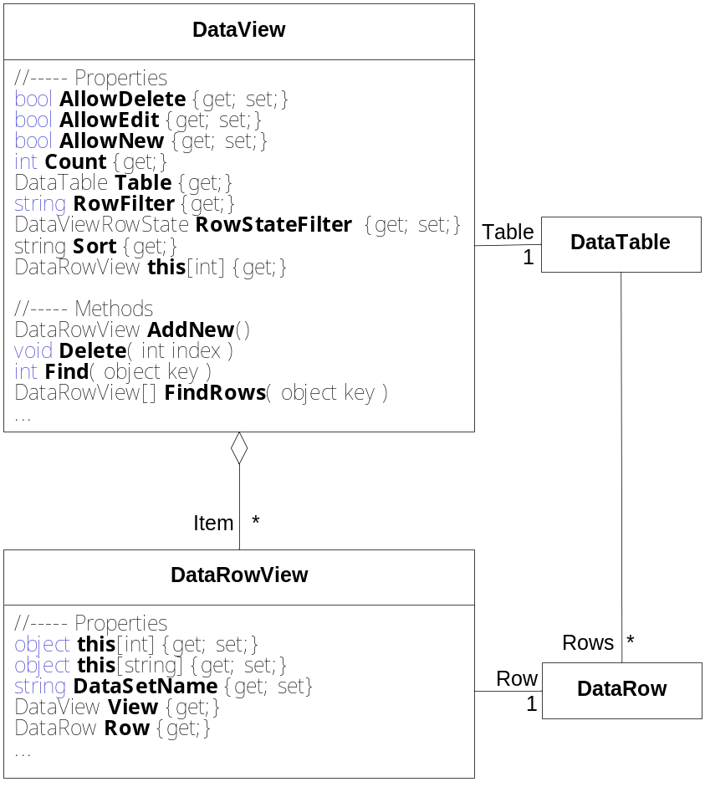
DataView
DataViews support views of tables
  RowFilter: Filtering based on filter expression
  RowStateFilter: Filtering based on row states
  Sort: Sorting based on columns
DataView supports
  changing data rows
  fast search (based on sorted columns)
DataView objects can be displayed by GUI elements
  e.g. DataGrid

Slide 67
Working with DataView
Create DataView object and set filter and sorting criteria
DataView a_kView = new DataView(personTable);
dataView.RowFilter = "FirstName <= 'K'";
dataView.RowStateFilter =
DataViewRowState.Added | DataViewRowState.ModifiedCurrent;
dataView.Sort = "Name ASC"; // sort by Name in ascending order
Display data in DataGrid
DataGrid grid = new DataGrid();
...
grid.DataSource = dataView;
Fast search for row based on "Name" column
int i = dataView.Find("Beer");
grid.Select(i);

Slide 68
ADO.NET
Introduction
Connection-oriented Access
Transactions
Connectionless Access
Database Access with DataAdapter
DataSets and DataReader
Integration with XML
Summary

Slide 69
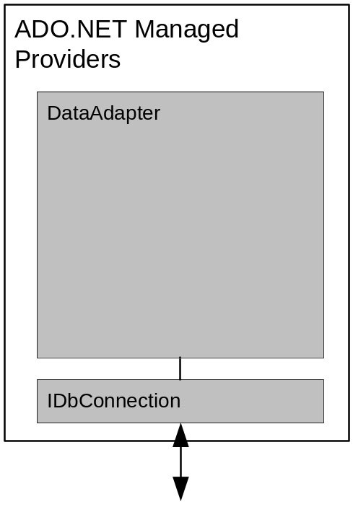
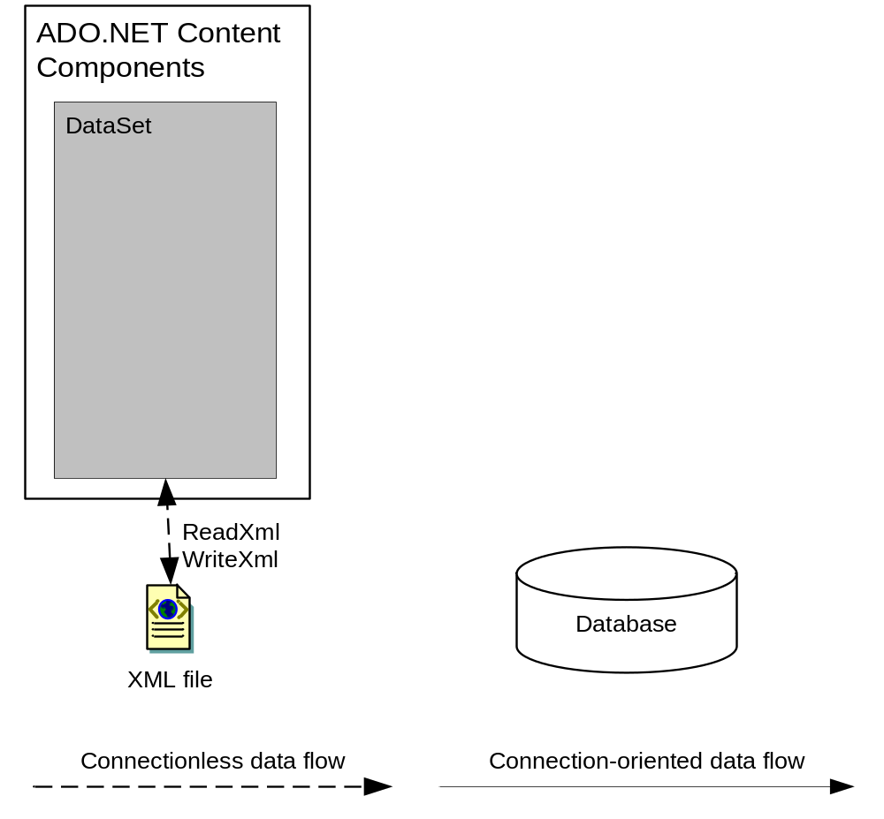
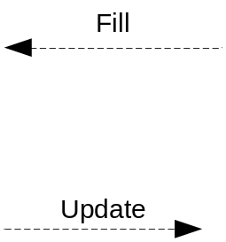
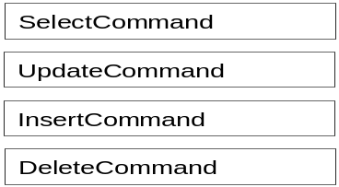

Architecture
DataAdapter for connection to data source
  Fill: Filling the DataSet
  Update: Writing back changes
DataAdapters use Command objects
  SelectCommand
  InsertCommand
  DeleteCommand
  UpdateCommand
TableMappings: mapping from
  table data base table to DataSet table
connectionless
connection-oriented

Slide 70
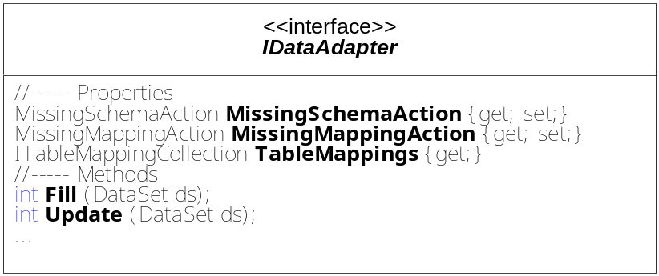
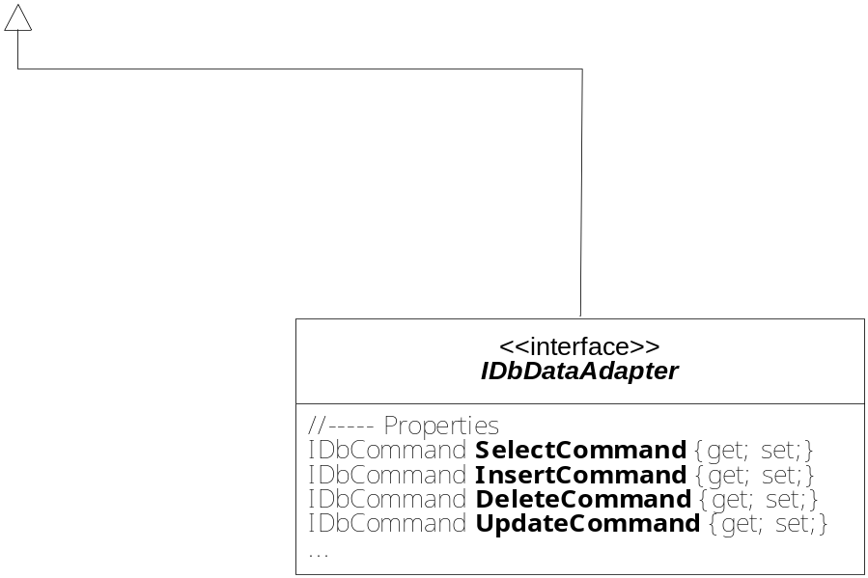
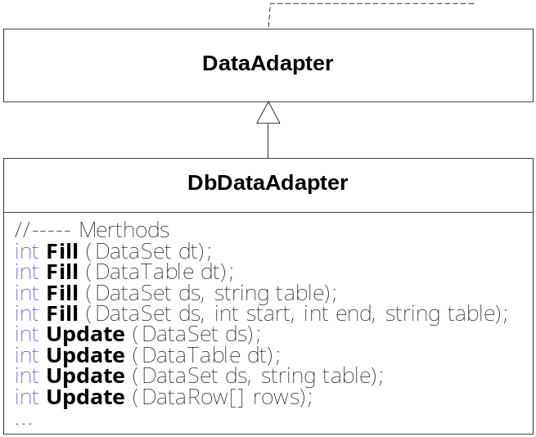
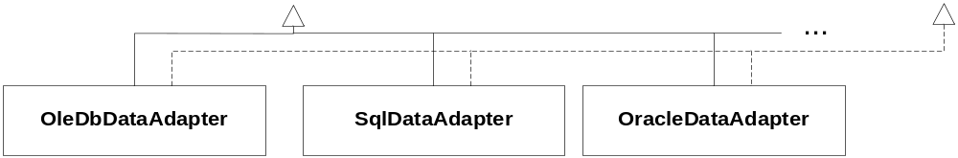
DataAdapter Class Diagram
Notes:
Überblick

Slide 71
DataAdapter: Loading Data
Create DataAdapter object and set SelectCommand
IDbDataAdapter adapter = new OleDbDataAdapter();
OleDbCommand cmd = new OleDbCommand();
cmd.Connection = new OleDbConnection ("provider=SQLOLEDB; ..." );
cmd.CommandText = "SELECT * FROM Person";
adapter.SelectCommand = cmd;
Read data from data source and fill DataTable "Person"
adapter.Fill(ds, "Person");
Only works when DataTable „Person“ already exists!
And is compatible to database table!
Accept or discard changes
Delete DataAdapter object
if (ds.HasErrors) ds.RejectChanges();
else ds.AcceptChanges();
if (adapter is IDisposable) ((IDisposable)adapter).Dispose();

Slide 72
DataAdapter: Loading Schema and Data
Create DataAdapter object and set SelectCommand
IDbDataAdapter adapter = new OleDbDataAdapter();
OleDbCommand cmd = new OleDbCommand();
cmd.Connection = new OleDbConnection ("provider=SQLOLEDB; ..." );
cmd.CommandText = "SELECT * FROM Person; SELECT * FROM Contact";
adapter.SelectCommand = cmd;
Define action for missing schema and mapping to tables
adapter.MissingSchemaAction = MissingSchemaAction.AddWithKey;
adapter.TableMappings.Add("Table", "Person");
adapter.TableMappings.Add("Table1", "Contact");
Add
AddWithKey
Error
Ignore
Read data from data source and fill DataTable "Person"
adapter.Fill(ds);
Accept or discard changes; delete DataAdapter object
if (ds.HasErrors) ds.RejectChanges();
else ds.AcceptChanges();
if (adapter is IDisposable) ((IDisposable)adapter).Dispose();

Slide 73
Schema Discovery
DataAdapter does not read foreign key relations
Rading read foreign key relations with GetOleDbSchemaTable
Example: Reading foreign key relations and creation of a DataRelation
try {
DataTable schemaTable =conn.GetOleDbSchemaTable(
OleDbSchemaGuid.Foreign_Keys, null);
foreach (DataRow r in schemaTable.Rows) {
DataTable parentTab = ds.Tables[r["PK_TABLE_NAME"].ToString()];
DataTable childTab = ds.Tables[r["FK_TABLE_NAME"].ToString()];
DataRelation rel = new DataRelation(
parentTab.TableName + "_" + childTab.TableName,
parentTab.Columns[r["PK_COLUMN_NAME"].ToString()],
childTab.Columns[r["FK_COLUMN_NAME"].ToString()] );
ds.Relations.Add(rel);
}
}
catch (Exception ex) { … }
}
Read information about foreign key relations
Each row contains information for one relation
For each row get the name of primary and foreign key table
and respective columns
Create DataRelation for DataSet
add DataRelation to DataSet

Slide 74
Schema Discovery
DataAdapter does not read foreign key relations
Rading read foreign key relations with GetOleDbSchemaTable
Example: Reading foreign key relations and creation of a DataRelation
try {
DataTable schemaTable =conn.GetOleDbSchemaTable(
OleDbSchemaGuid.Foreign_Keys, null);
foreach (DataRow r in schemaTable.Rows) {
DataTable parentTab = ds.Tables[r["PK_TABLE_NAME"].ToString()];
DataTable childTab = ds.Tables[r["FK_TABLE_NAME"].ToString()];
DataRelation rel = new DataRelation(
parentTab.TableName + "_" + childTab.TableName,
parentTab.Columns[r["PK_COLUMN_NAME"].ToString()],
childTab.Columns[r["FK_COLUMN_NAME"].ToString()] );
ds.Relations.Add(rel);
}
}
catch (Exception ex) { … }
}
Read information about foreign key relations
Each row contains information for one relation
"Person"
For each row get the name of primary and foreign key table
and respective columns
Create DataRelation for DataSet
add DataRelation to DataSet
"Contact"
"Person_Contact"
"ID"
"PersonID"

Slide 75
DataAdapter: Writing Back Changes (1)
Changes are written back with Update method
Update-, Insert- and DeleteCommand define how changes are written
CommandBuilder can create Update-, Insert- und DeleteCommand from SelectCommand automatically (in simple cases )
Conflict management for updates:
  comparison of data in DataTable and data source
  in case of conflict DBConcurrencyException is thrown

Slide 76
DataAdapter: Writing Back Changes (2)
Create DataAdapter with SELECT expression
OleDbConnection con = new OleDbConnection ("provider=SQLOLEDB; …");
adapter = new OleDbDataAdapter("SELECT * FROM Person", con);
Create update commands using CommandBuilder
OleDbCommandBuilder cmdBuilder = new OleDbCommandBuilder(adapter);
Call Update and handle conflicts
try {
adapter.Update(ds, tableName);
} catch (DBConcurrencyException) {
// Handle the error, e.g. by reloading the DataSet
}
adapter.Dispose();

Slide 77
DataAdapter: Event Handling
Two events signaled on updates for each data row
  OnRowUpdating: just before updating the data source
  OnRowUpdated: just after updating the data source
public sealed class OleDbDataAdapter : DbDataAdapter, IDbDataAdapter
{
public event OleDbRowUpdatingEventHandler RowUpdating;
public event OleDbRowUpdatedEventHandler RowUpdated;
…
}
public delegate void OleDbRowUpdatedEventHandler( object sender,
OleDbRowUpdatedEventArgs e );
public sealed class OleDbRowUpdatedEventArgs : RowUpdatedEventArgs {
public DataRow Row {get;}
public StatementType StatementType {get;}
public UpdateStatus Status {get; set;}
…
}

Slide 78
DataAdapter: Event Handling Example
Define handler methods
private void onRowUpdating(object sender, OleDbRowUpdatedEventArgs args) {
Console.WriteLn("Updating row for {0}", args.Row[1]);
...
}
private void onRowUpdated(object sender, OleDbRowUpdatedEventArgs args) {
...
}
Add delegates to events of DataAdapter
OleDbDataAdapter adapter = new OleDbDataAdapter();
...
da.RowUpdating += new OleDbRowUpdatingEventHandler(this.OnRowUpdating);
da.RowUpdated += new OleDbRowUpdatingEventHandler(this.OnRowUpdated);

Slide 79
ADO.NET
Introduction
Connection-oriented Access
Transactions
Connectionless Access
Database Access with DataAdapter
DataSets and DataReader
Integration with XML
Summary

Slide 80
Filling DataSets with DataReader
DataSet can be filled using DataReader
  LoadOption for overwriting original and current values in DataSet:
  OverwriteChanges: overwrite original and current values
  PreserveChanges: overwrite original values; leave current values
  Upsert: overwrite current values; leave original values
public void Load (IDataReader reader, LoadOption loadOption, params DataTable[] tables)
public void Load (IDataReader reader, LoadOption loadOption, params string[] tables)
public void Load (IDataReader reader,LoadOption loadOption,
FillErrorEventHandler errorHandler, params DataTable[] tables)
Example:
//---- create DataReader
IDataReader reader = cmd.ExecuteReader();
//---- create DataSet and load data using reader
DataSet ds = new DataSet("PersonContacts");
ds.Load(reader, LoadOption.OverwriteChanges, "Person", "Contact");

Slide 81
Reading DataSets using DataReader
DataTableReader for sequential reading of DataSet
Creation of DataTableReaders with CreateDataReader
Example: Output of all rows of all tables in a DataSet
static void Print(DataSet ds) {
DataTableReader r = ds.CreateDataReader();
int i = 1;
do {
Console.WriteLine(" ---- Table " + i + "----------------");
while (r.Read()) {
object[] vals = new object[r.FieldCount];
r.GetValues(vals);
foreach (object v in vals) {
Console.Write(v.ToString() + " - ");
}
Console.WriteLine();
}
i++;
} while (r.NextResult());
}
Create DataReader for DataSet
Iteration over all tables
Read next row in current table
Iteration over all column values of
currrent row

Slide 82
ADO.NET
Introduction
Connection-oriented Access
Transactions
Connectionless Access
Database Access with DataAdapter
DataSets and DataReader
Integration with XML
Summary

Slide 83
DataSet und XML Integration
DataSets and XML are highly integrated
  serializing DataSets as XML documents
  XML documents as data sources for DataSets
  schemas for DataSets defined as XML schemas
  strongly typed DataSets generated from XML schemas
  access to DataSets using XML-DOM interface
Integration of DataSets and XML used in distributed systems,
e.g., Web Services
  (see Microsoft 3-Tier Architecture)

Slide 84
Writing and Reading XML Data
Methods for writing and reading XML data
public class DataSet : MarshalByValueComponent, IListSource,
ISupportInitialize, ISerializable {
public void WriteXml( Stream stream );
public void WriteXml( string fileName );
public void WriteXml( TextWriter writer);
public void WriteXml( XmlWriter writer );
public void WriteXml( Stream stream, XmlWriteMode m );
…
public XmlReadMode ReadXml ( Stream stream );
public XmlReadMode ReadXml ( string fileName );
public XmlReadMode ReadXml ( TextWriter writer);
public XmlReadMode ReadXml ( XmlWriter writer );
public XmlReadMode ReadXml ( Stream stream, XmlReadMode m );
...
}
public enum XmlWriteMode {DiffGram, IgnoreSchema, WriteSchema}
public enum XmlReadMode {
Auto, DiffGram, IgnoreSchema, ReadSchema, InferSchema, Fragment }
Notes:
Überblick

Slide 85
Example: Writing and Reading XML Data
<?xml version="1.0" standalone="yes" ?>
<PersonContacts>
- <Person>
<ID>1</ID>
<FirstName>Wolfgang</FirstName>
<Name>Beer</Name>
</Person>
- <Person>
<ID>2</ID>
<FirstName>Dietrich</FirstName>
<Name>Birngruber</Name>
</Person>
<Contact>
<ID>1</ID>
<FirstName>Dietrich</FirstName>
<Name>Birngruber</Name>
<NickName>Didi</NickName>
<EMail>didi@dotnet.jku.at</EMail>
<Phone>7133</Phone>
<PersonID>2</PersonID>
</Contact>
- <Contact>
<ID>2</ID>
<FirstName>Wolfgang</FirstName>
<Name>Beer</Name>
...
<PersonID>1</PersonID>
</Contact>
</PersonContacts>
Write data to XML file
ds.writeXML("personcontact.xml");
Read data from XML
  with XmlReadMode.Auto a schema is generated automatically
DataSet ds = new DataSet(); ds.readXML("personcontact.xml",
XmlReadMode.Auto);

Slide 86
DataSet and XML Schema
DataSets allow reading and writing XML schemas
  WriteXmlSchema: Writes XML schema
  ReadXmlSchema: Reads XML schema and constructs DataSet
  InferXmlSchema: Reads XML data and infers schema from data
...
public void WriteXmlSchema ( Stream stream );
public void WriteXmlSchema ( string fileName );
public void WriteXmlSchema ( TextWriter writer);
public void WriteXmlSchema ( XmlWriter writer );
public void ReadXmlSchema ( Stream stream );
public void ReadXmlSchema ( string fileName );
public void ReadXmlSchema ( TextWriter writer);
public void ReadXmlSchema ( XmlWriter writer );
public void InferXmlSchema ( Stream stream, string[] namespaces );
public void InferXmlSchema ( string fileName, string[] namespaces );
public void InferXmlSchema ( TextWriter writer, string[] namespaces );
public void InferXmlSchema ( XmlWriter writer, string[] namespaces );
}

Slide 87
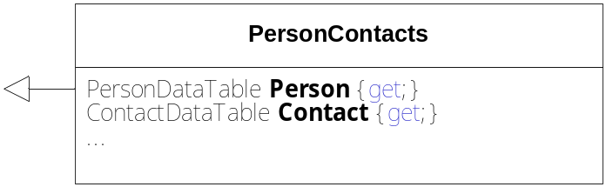
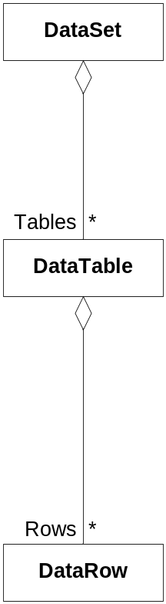
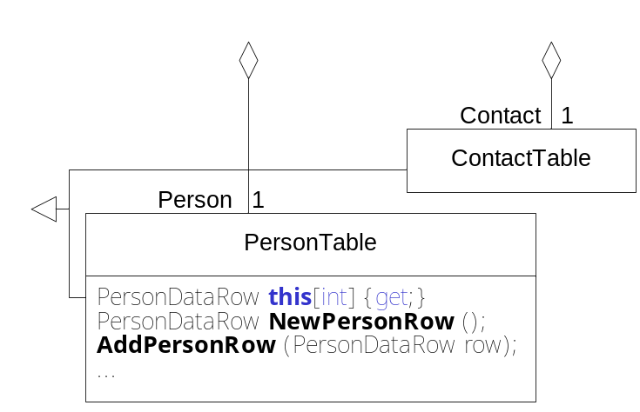
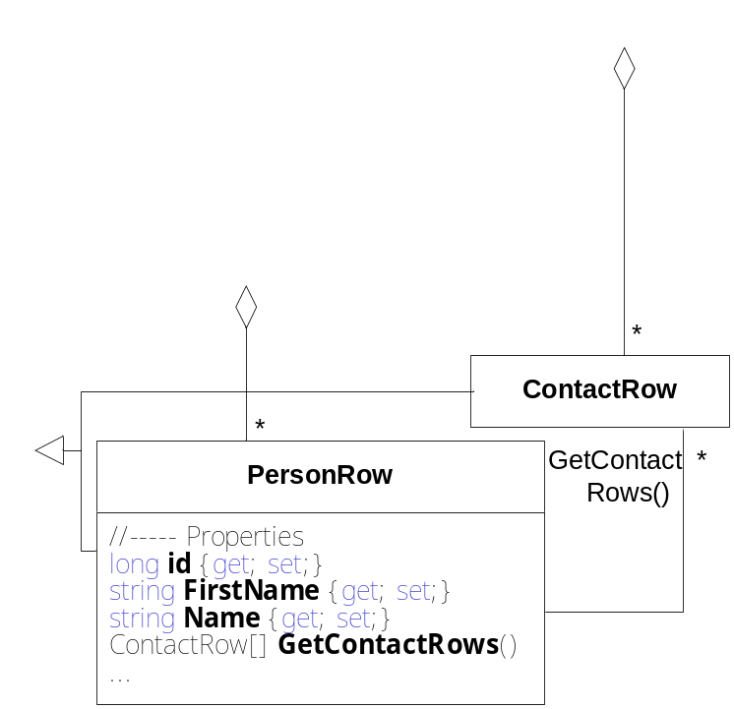
Typed DataSets
Typed DataSets provide typed data access
Tool xsd.exe generates classes from XML schema
Classes define properties for typed access to rows, columns, and relations
> xsd.exe personcontact.xsd
/dataset

Slide 88
Example Typed DataSets
Data access in conventional DataSet
DataSet ds = new DataSet("PersonContacts");
DataTable personTable = new DataTable("Person");
...
ds.Tables.Add(personTable);
DataRow person = personTable.NewRow();
personTable.Rows.Add(person);
person["Name"] = "Beer";
...
person.GetChildRows("PersonHasContacts")[0]["Name"] = "Beer";
Data access in typed DataSet
PersonContacts typedDS = new PersonContacts();
PersonTable personTable = typedDS.Person;
Person person = personTable.NewPersonRow();
personTable.AddPersonRow(person);
person.Name = "Beer";
...
person.GetContactRows()[0].Name = "Beer";

Slide 89
Access to DataSets using XML-DOM
XmlDataDocument allows to access DataSet over XML-DOM interface
Synchronisation of changes in XmlDataDocument and DataSet
Example:
Create XmlDataDocument object for DataSet object
Change data in DataSet
XmlDataDocument xmlDoc = new XmlDataDocument(ds);
...
DataTable table = ds.Tables["Person"];
table.Rows.Find(3)["Name"] = "Changed Name!";
Access changed data from XmlDataDocument object
XmlElement root = xmlDoc.DocumentElement;
XmlNode person = root.SelectSingleNode(“/person[ID='3']"); Console.WriteLine("Access via XML: \n" + person.OuterXml);
Access via XML:
<person id ="2">
<firstname>Dietrich</firstname>
<name>Changed Name!</name>
…

Slide 90
ADO.NET
Introduction
Connection-oriented Access
Transactions
Connectionless Access
Database Access with DataAdapter
DataSets and DataReader
Integration with XML
Summary

Slide 91
Summary
Connection-oriented data access model
  for applications with only a few parallel, short running transactions
  object-oriented interface abstracts from data source
  access to database by SQL commands
Connectionless data access model
  for applications with many parallel, long running transactions
  DataSet as main memory data base
  DataAdapter is used as connector to the data source
  tight integration with XML
  well integrated in the .NET Framework (e.g.: WebForms, WinForms)

